Slide 2
Cybersecurity Fundamentals
What you have
INVENTORY
VULNERABILITIES
CONNECTIONS
What’s at risk
How it’s connected

Slide 3
Digital Resilience | Guiding Principles
Be hard to hit
Detect immediately
Respond rapidly

Slide 4
RedSeal Business Outcomes
Reconcile network inventory and secure your configurations
Ensure complete endpoint protection and scan coverage
Continually validate compliance and network segmentation
Measure your security posture, prioritize vulnerabilities
Are vulnerabilities prioritized based on network access?
Are your cyber security measures paying off?
Are your network devices accounted for?
Are they securely configured?
Are your hosts accounted for?
Are there gaps in endpoint scan and protection coverage?
Is your network configured as designed?
Is your network segmentation implementation validated?
Drive risk-based, prioritized remediations

Slide 5
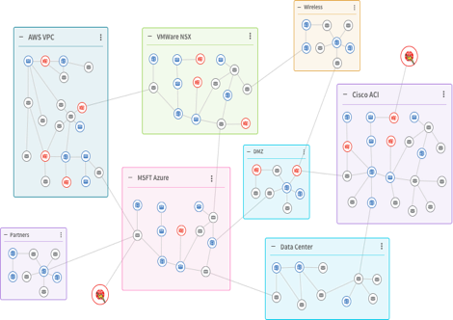
The Platform | Information to Enable Fundamentals
Model public cloud
Model private cloud
Routers
Host and Vulnerability data
Firewalls
Access Points
Switches
Load
Balancers
Cloud “configs”
Network Configuration Managers
As-built network model
Model on-prem networks

Slide 6
Rich Integrations Ecosystem
Reconcile network inventory and secure your configurations
Ensure complete endpoint protection and scan coverage
Continually validate compliance and network segmentation
Measure your security posture, prioritize vulnerabilities
Public Cloud
Host Inventory - Endpoint Firewall/AV
SIEM
Risk Management
Private Cloud
Firewall - LB – Routers - Switches
ITSM
Vulnerability Scanners
Network Inventory

Slide 7
Network Inventory and Topology
A
Ensure every network asset is accounted for
DISCOVER ALL NETWORK DEVICES
Enhance inventory coverage for L3/L2 by identifying missing devices Update NCCM systems Conform with industry network configuration best practices Compliance with control frameworks like CIS/DISA STIG Check configurations for PCI DSS compliance Firewall rule cleanup
B
Check network devices against industry standards for secure configurations
C
Write custom checks for your proprietary security controls

Slide 8
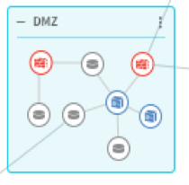
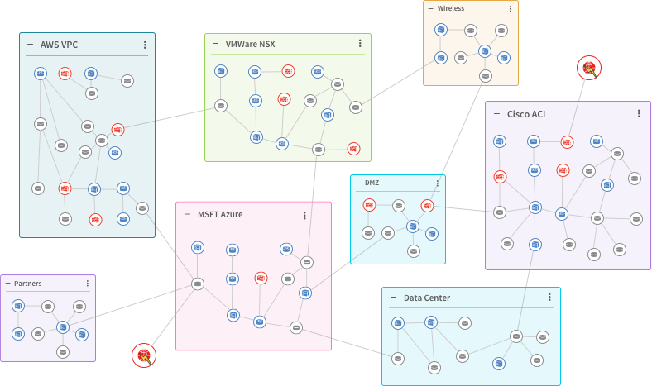
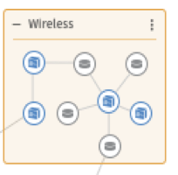
Find and Secure Network Devices
Unknown lab
Unintended link
Weak SNMP protocol and password
Weak device passwords
Poorly configured firewall
Unwanted protocol still active

Slide 9
Endpoints and Scan Coverage
A
ENHANCE SECURITY POSTURE BY FINDING UNKNOWNS
Reconcile multiple sources of endpoint data to identify gaps Update EDR coverage Vulnerability scan coverage Inventory Management Systems Identify endpoint differences between multiple scanners
Find security tool coverage gaps
B
Reconcile hosts with network
C
Correlate endpoint product coverage and results

Slide 10
Host Data: Identify Gaps
Identify differences between endpoint data sources
Determine gaps in vulnerability scan coverage
Determine gaps in EDR agent coverage
Update CMDB, NCCM, vulnerability scanners, patching systems

Slide 11
Network Inconsistencies and Segmentation
A
IDENTIFY NETWORK SECURITY GAPS
A digital model of the network Find inconsistencies in your network Overlapping IP space, duplicate VLANs Assess risks related to network/firewall changes Get broad visibility across on-premise, cloud, and virtual environments
Model across on-premise, cloud, and virtual environments
B
Validate network segmentation for PCI DSS, NERC-CIP and other policies
C
Assess risks related to network/firewall changes

Slide 12
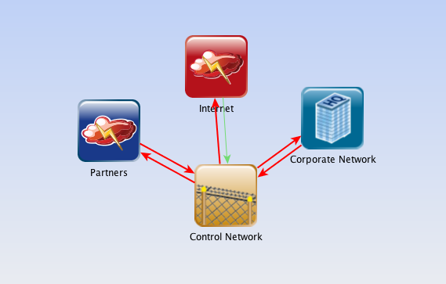
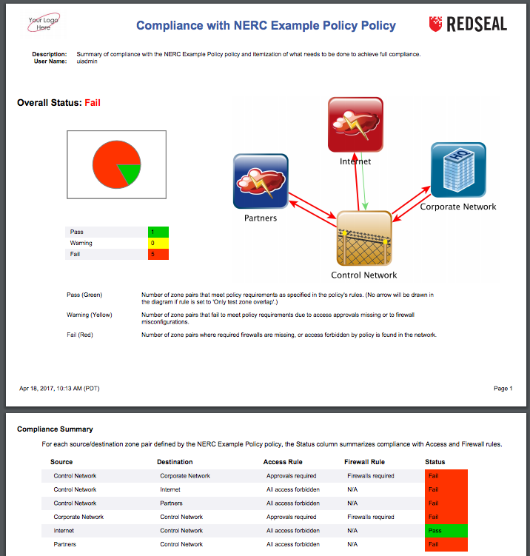
Compliance with Policies and Regulations
Self-defined or mandated “Access Policy Zones”
Users, applications and data
Continuous monitoring and report generation
Ongoing vs. snapshot compliance
Reduced time/cost for complete audits

Slide 13
Risk Scoring and Digital Resilience
A
MEASURE AND PRIORITIZE RISK
Prioritize risk based on access paths available to an attacker Investigate incidents more quickly, including where it is and where an attacker can reach Measure effectiveness of security strategy Automate through workflow integration to accelerate security remediations
Prioritize vulnerabilities
B
Accelerate incident investigation
C
Measure effectiveness of security strategy
6/17/20

Slide 14
Fix High-Risk Vulnerabilities First with Network Context
Has access to critical assets
With RedSeal
Remediation order
1.
2.
3.
4.
No access to critical assets or untrusted networks
CVSS 9
CVSS 6
CVSS 4
CVSS 7
CVSS 6
CVSS 7
CVSS 7
CVSS 7
CVSS 9
CVSS 9
CVSS 4
CVSS 9
CVSS 6
CVSS 6
Is a critical asset
Exposed to untrusted network
CVSS 4
CVSS 4

Slide 15
Accelerate Incident Response with Network Context
Reachable targets
Reachable Targets
IoC
Possible command and control
6/17/20

Slide 16
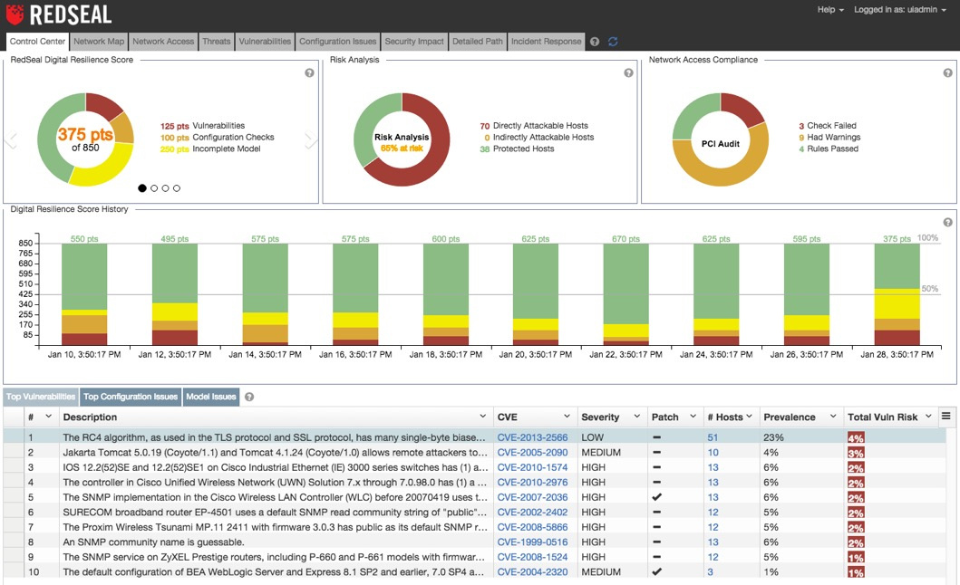
Risk Measurement: Digital Resilience Score
Digital Resilience Score
Access policy status
Trending
Actionable intelligence
6/17/20

Slide 17
What Do You Have, How Is It Connected and What’s at Risk?
Risk
Network
Assets
Endpoints
Network
Risk scoring and digital resilience
Measure your security posture
Network inventory and secure configurations
Find and secure network devices
Endpoint inventory
Ingest, reconcile and contextualize host data
Network segmentation
Build network model and validate segmentation

Slide 18
Master the fundamentals of cybersecurity with RedSeal

Slide 19
Managed Services: Cyber Business Outcomes
Cyber Visibility
Identify-to-protect critical business activities and assets
Compliance
Regulatory, industry, and internal
Risk Management
Risk assessment, mitigation, and resilience
Notes:
1. Cyber Visibility: Knowing what network/end-points customers have on the network and what they doing is critical for security. Keeping an asset inventory up to date isn’t as easy as it sounds in today’s dynamic environment. User audits generally uncover devices that are critical but undocumented. (From Cisco Cyber Security Report). First step for any security initiative is to identify the key business activity and the risks to it; the systems that support that activity;
2. Once the assets are identified, the next step is to identify the potential types of attacks and possible consequences; and the adversaries most likely to carry attacks out.
3. Outlining details about the activities, assets, and possible types of attacks will help companies recognize and prioritize their risks and prepare remedial actions.

Slide 20
Build Service: Initial Implementation
Design and implement the system
Deliver faster time to value
Establish a security baseline
Set up automation for regular assessments
Build Package
Outcomes delivered:
Network inventory and secure configuration assessment
Endpoint inventory
Network segmentation
Vulnerability prioritization

Slide 21
Managed Services: Continuous Risk Management
Risk Management Package
Security posture monitoring
Incident investigation
Vulnerability risk prioritization
Includes Compliance package
Compliance Package
Network segmentation and compliance monitoring
Security change review
Includes Cyber Visibility package
Cyber Visibility Package
Network and endpoint Inventory assessments
Secure configuration assessments
Knowledge transfer
Value to Customer
Customer Outcomes with RedSeal
Notes:
Risk management needs to be a continuous process to avoid hitting “Risk Debt”.
Your Security teams must
Respond to new security risks
Stay ahead of constantly evolving cyber threats
Be proactive when the business is constantly launching new digital initiatives
RedSeal Subscription Services offer
Experienced PSE Network and Security engineers to provide ongoing assessments and prioritize recommendations to reduce the “Risk Debt”
Prioritize issues that are most critical to business
Work with your teams to mitigate risks
Operate Package Customer Benefits
Continue to provide visibility into what assets customer has and how they are connected
Identify set of baseline access controls and network best practices
Develop and execute on a roadmap for the security team
Prioritize the implementation of controls
Maintain good state of basic security operational hygiene
Accelerate Package Benefits:
Focused remediation - move away from “patch everything” to “patch what matters the most” based on asset criticality and risk radius
Keep critical assets up to date to protect against compromise from cyberattacks
Ensure that regulatory requirements are met
Transform Package Benefits:
Become Cyber-Resilient
Use quantitative risk data for decision making
Integrate security with people and business process through strong stakeholder alignment

Slide 22
Thank you.

Slide 23
Digital Resilience is Based on Fundamentals
The goal: resilience to cyber events.
Cannot be done without the fundamentals.

